Slide 1

Credit Card Fraud Detection with Machine Learning
Aswath Rangachari |Janani Balaji

Slide 2
AGENDA
01
Introduction: What's Credit Card Fraud
02
Existing Techniques and Tools for Fraud Detection
Why Machine Learning?
03
Methodology
04
05
Dataset Context
Appendix
06
07
Conclusion

Slide 3


Stats You Need To Know
$40 3rd
Billion expected Credit Card Fraud Third Place in Fraud - USA in in 2027
$209k 47%
Breached Credit Accounts in 2018 World's credit card fraud happens ri right here in the U.S.

Slide 4
01
Introduction

Slide 5

What’s Credit Card Fraud
Credit card fraud is the unauthorized use of a credit or
debit card, or similar payment tool to fraudulently
obtain money or property.
Credit card fraud is the most prevalent type of identity
theft.
Types of Credit Card Fraud:
- Stolen or Lost Credit Card Fraud
- Credit Card Phishing
- Fraudulent Card Applications
- Fake Credit Cards
- Fraud Conducted by Data Breaches

Slide 6
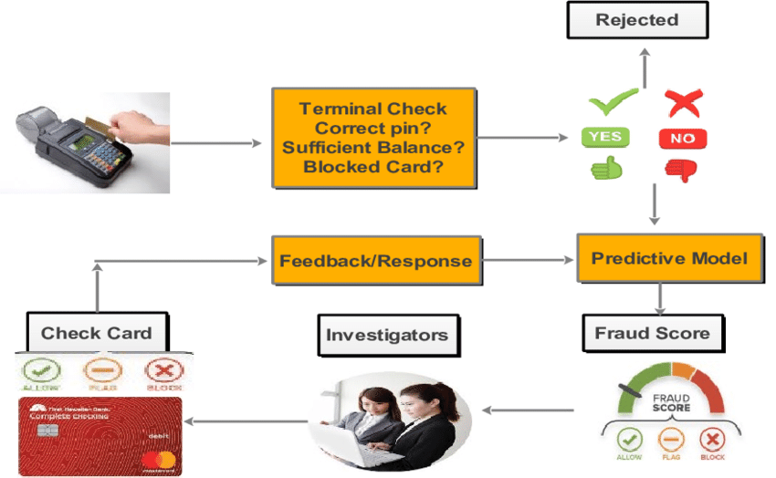
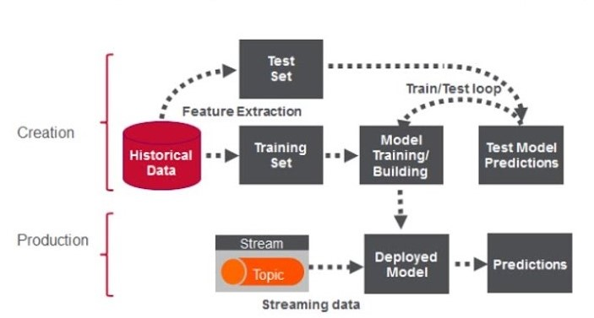
Credit Card Fraud Detection Process

Slide 7
02
Existing Techniques and Tools for Detection

Slide 8
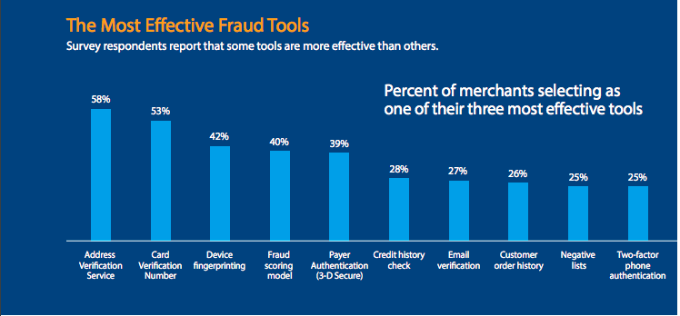
Existing Techniques and Tools for Fraud Detection
Risk Scoring
Two-factor phone authentication
3D-SECURE for e-commerce transactions
EMV PIN technology for face-to-face transactions
Card Verification Number
Email Verification
Device Fingerprinting

Slide 9
03
Why Machine Learning?

Slide 10
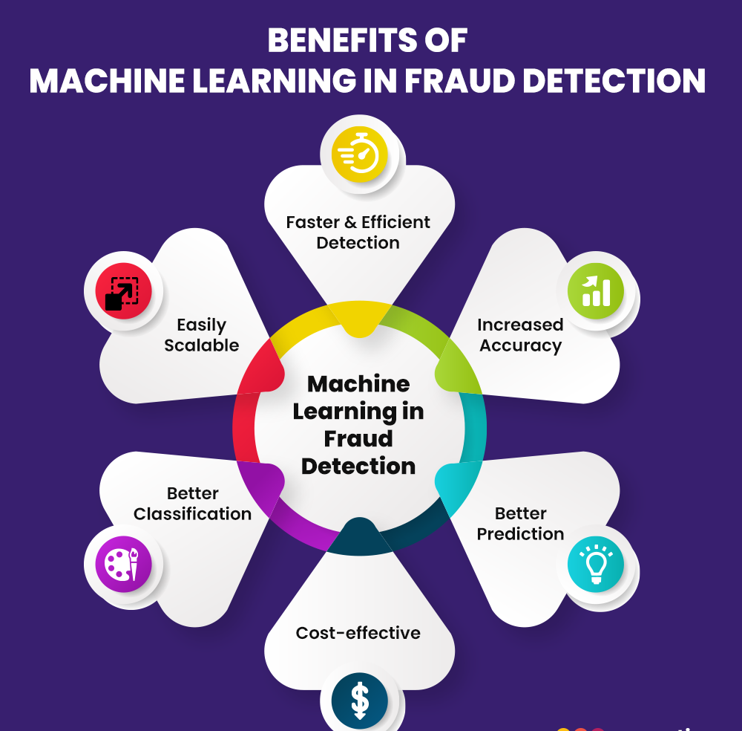
Why Machine Learning?
Machine Learning algorithms appear more
effective than humans when it comes to the
speed of information processing.
Fraud Detection with Machine Learning becomes possible due to the ability of ML algorithms to
learn from historical fraud patterns and recognize
them in future transactions.
Machine Learning algorithms are able to find
sophisticated fraud traits that a human simply
cannot detect.

Slide 11
Comparison between ML and Conventional Credit Card Fraud Detection
Machine Learning Credit Card Fraud Detection | Conventional Credit Card Fraud Detection
Detecting fraud automatically | Determining schemes should be set manually
Real-time streaming | Takes an enormous amount of time
Less time needed for verification methods | Multiple verification methods are needed
Identifying hidden correlations in data | Finds only obvious fraud activities

Slide 12
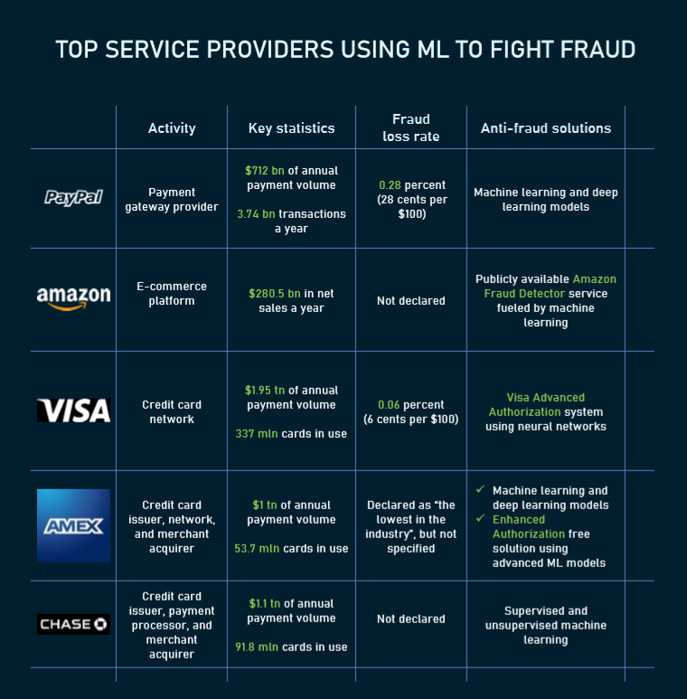
Big Players: What they do to protect online payments

Slide 13
04
Methodology

Slide 14
Methodologies for the Topic
Logistic Regression
Classifier
Machine
Learning
Classification Models
Random Forest
Classifier
Vector Support
Classifier
Gradient Boosting Classifier

Slide 15
05
Dataset Context

Slide 16
Dataset Context
Dataset:
The data contains 284,807 European credit card transactions with 492 fraudulent transactions that occurred over two
days in September 2013.
The dataset is highly unbalanced, the positive class (frauds) account for 0.172% of all transactions. Given the class imbalance
ratio, Area Under the Precision-Recall Curve (AUPRC) are recommend to measure the accuracy. Confusion matrix accuracy is not
meaningful for unbalanced classification due to this Accuracy Paradox.
Features V1, V2, ... V28 are the principal components obtained with PCA, the only features which have not been transformed
with PCA are 'Time' and 'Amount'.
Feature 'Time' contains the seconds elapsed between each transaction and the first transaction in the dataset.
The feature 'Amount' is the transaction Amount, this feature can be used for example-dependant cost-senstive learning.
Feature 'Class' is the response variable and it takes value 1 in case of fraud and 0 otherwise.
https://www.kaggle.com/mlg-ulb/creditcardfraud/download

Slide 17
06
Appendix

Slide 18
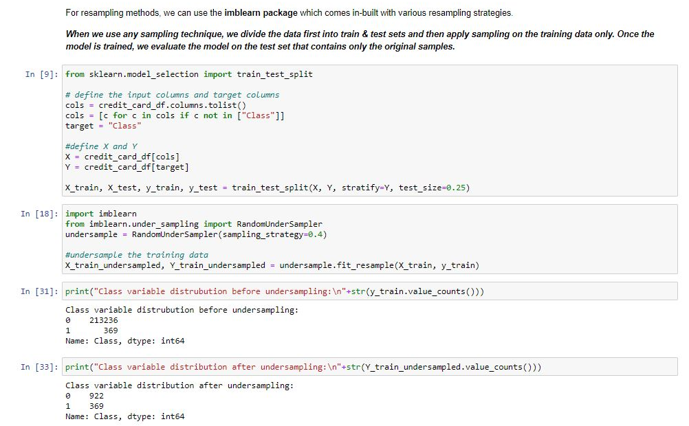
Appendix

Slide 19
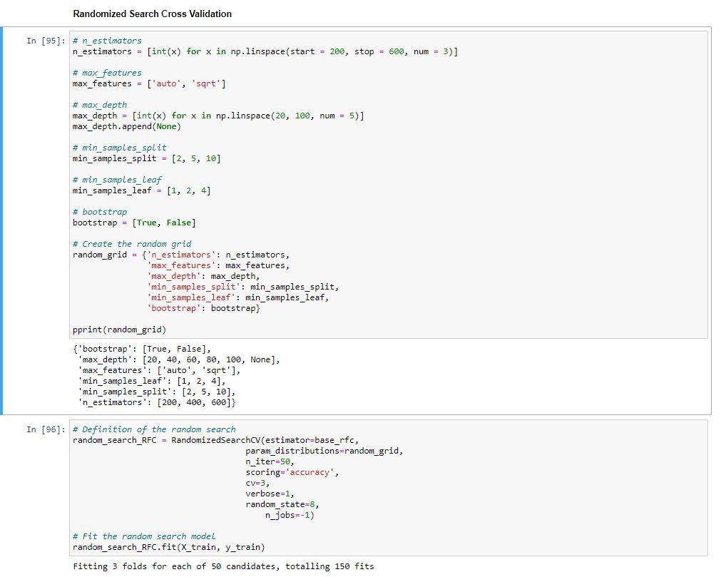
Appendix

Slide 20
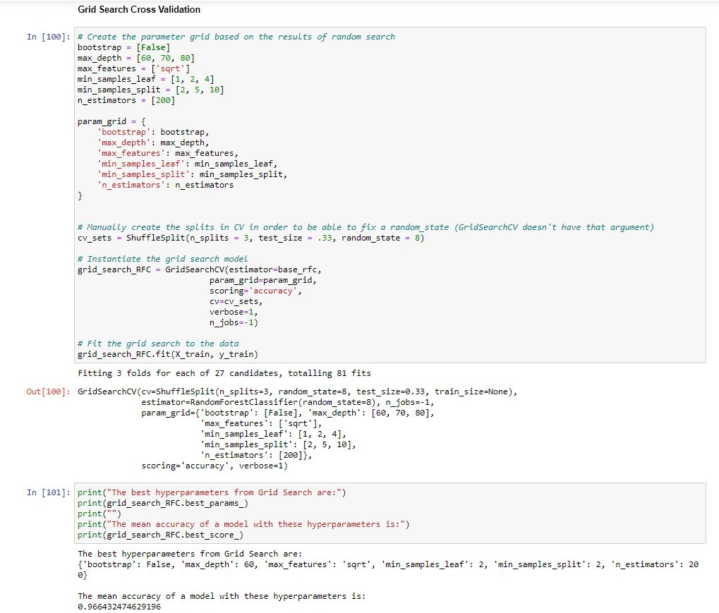
Appendix

Slide 21
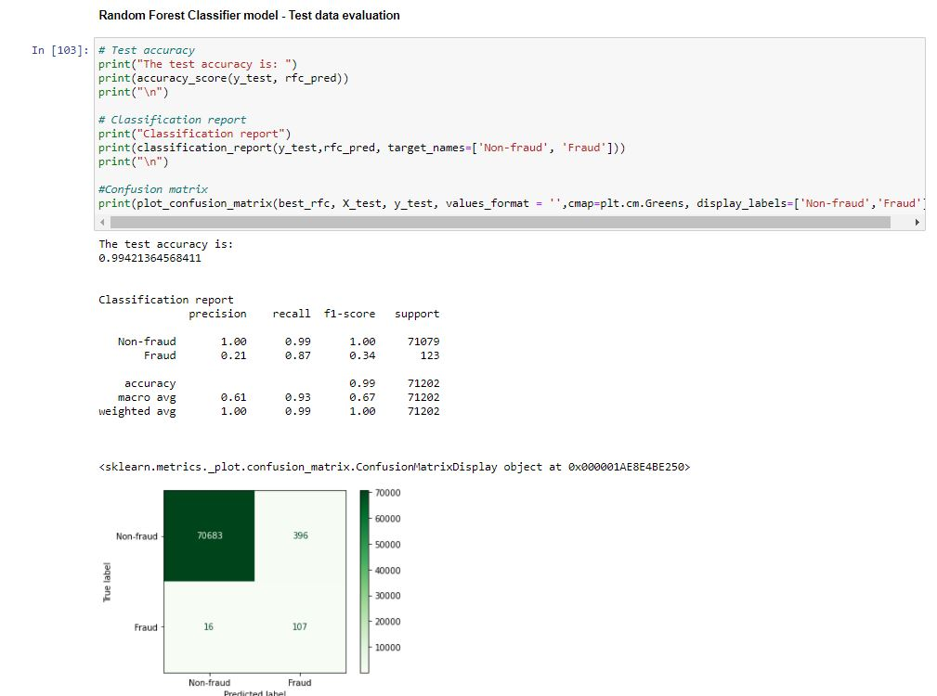
Appendix

Slide 22
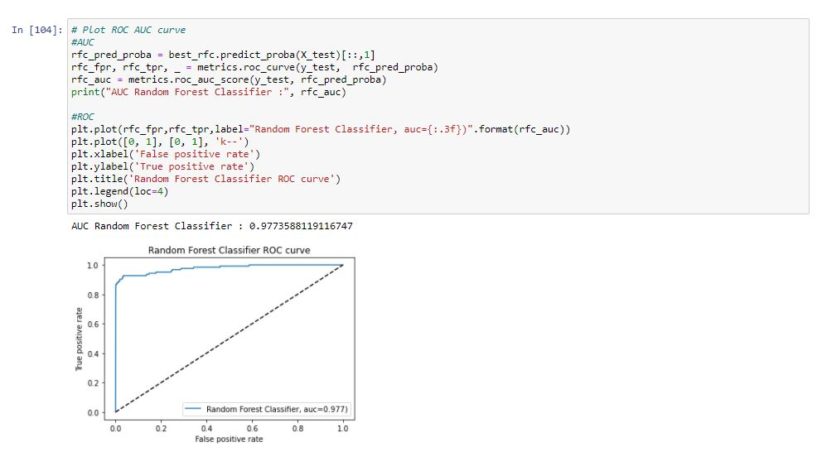
Appendix

Slide 23
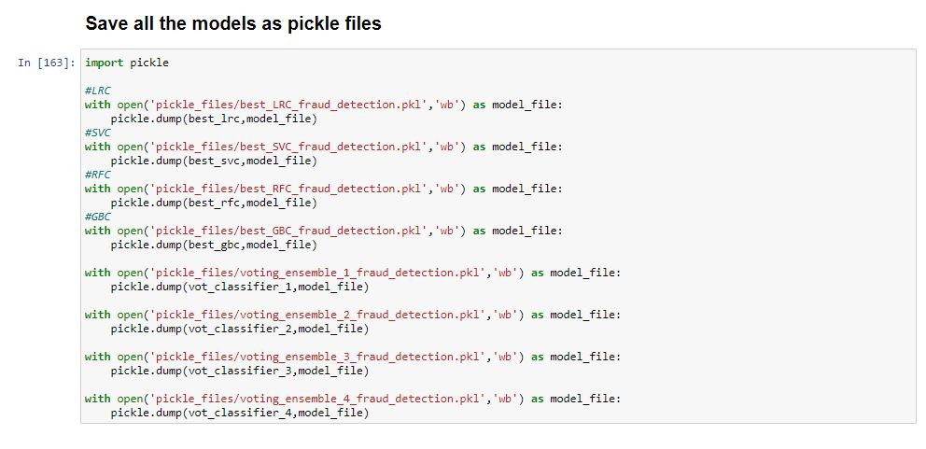
Appendix

Slide 24
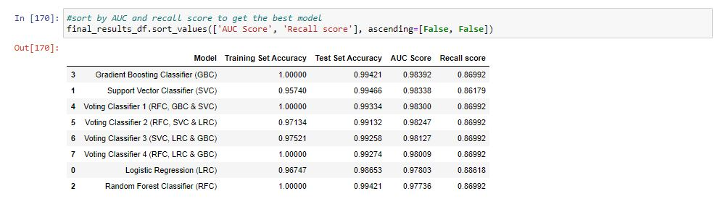
Model Comparison

Slide 25
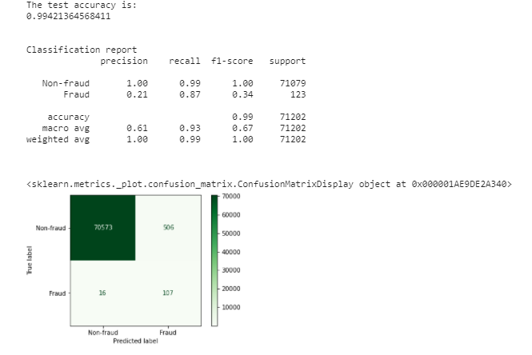
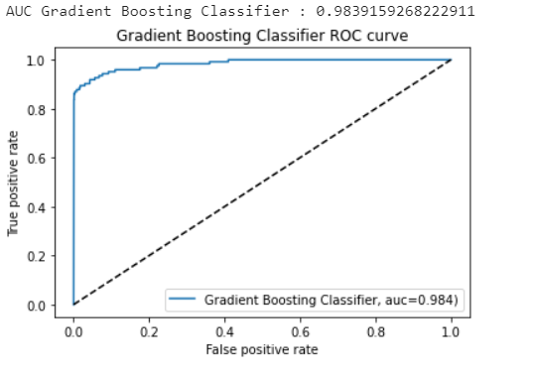
Efficient Model for Credit Card Fraud Detection
All the four models are extremely good in classifying a Fraud from Non Fraud transaction.
The AUC Score obtained are all above 0.96 which indicates the predicting power of all these models are good.
Out of all these models, Gradient Boosting Classifier have the highest accuracy score of 0.994 and AUC score
of 0.983 on the Test set.
Hence, Gradient Boosting Classifier considered to be the most efficient model for credit card fraud detection.

Slide 26
06
Conclusion

Slide 27
Conclusion
Different machine learning models were explored to develop a robust model for credit card fraud detection. All the
models have produced good results in both training and testing with very minute differences in performance.
The imbalance in the dataset was handled accordingly by using sampling and class weights during model training.
During the model training phase, by using Randomized Search and Grid Search Cross Validation for Hyper parameter
Tuning, the training accuracy of the models improved considerably in comparison with the baseline models (without
hyper parameter tuning).
Given that the dataset is imbalanced, getting a good accuracy is not the goal. However, the high AUC scores and Recall scores indicate that the models are quite robust in classifying fraudulent transactions and non-fraudulent transactions.

Slide 28
References
https://spd.group/machine-learning/credit-card-fraud-detection/#What_is_Credit_Card_Fraud_Detection
https://machinelearningmastery.com/imbalanced-classification-with-the-fraudulent-credit-card-transactions-dataset/
https://www.analyticsvidhya.com/blog/2020/08/exploratory-data-analysiseda-from-scratch-in-python/
https://machinelearningmastery.com/basic-data-cleaning-for-machine-learning/
https://www.analyticsvidhya.com/blog/2020/04/feature-scaling-machine-learning-normalization-standardization/
https://machinelearningmastery.com/tactics-to-combat-imbalanced-classes-in-your-machine-learning-dataset/
https://www.analyticsvidhya.com/blog/2017/03/imbalanced-data-classification/
https://www.kdnuggets.com/2020/01/5-most-useful-techniques-handle-imbalanced-datasets.html
https://www.analyticsvidhya.com/blog/2019/08/11-important-model-evaluation-error-metrics/

Slide 29
THANK YOU!
Do you have any
questions???

